Slide 1


Introduction to Artificial Intelligence
Book: Artificial Intelligence, A Modern Approach (Russell & Norvig)
Ybralem B.

Slide 2


Chapter Three: Lecture 1
Solving Problems by Searching and Constraint Satisfaction Problem

Slide 3
Chapter objectives:
Solving Problems by Searching and Constraint Satisfaction Problem
  Problem Solving by Searching
  Problem Solving Agents
  Problem Formulation
  Search Strategies
  Avoiding Repeated States
  Constraint Satisfaction Search

Slide 4
Problem Solving by Searching
Searching is a process to find the solution for a given set of problems.
Search algorithms are one of the most important areas of Artificial Intelligence.

Slide 5


Problem Solving Agents
In AI, Search techniques are universal problem-solving methods.
Rational agents or Problem-solving agents in AI mostly used these search strategies or algorithms to solve a specific problem and provide the best result.
Problem-solving agents are the goal-based agents and use atomic representations, that is; states of the world are considered as wholes, with no internal structure visible to the problem solving
Goal based agents that use factored/structured representation are usually called planning agents.

Slide 6
Functionality of Problem Solving Agent
Goal Formulation
Problem Formulation
Search
Solution
Execution
Limiting the Objectives of Current State
Action and States
Looking for sequences of actions
Search algorithm
Takes a problem as input and returns a solution
Executions of the best solution

Slide 7
Goal Formulation
Problem Formulation
Search
Solution
Execution
Limiting the Objectives of Current State
Action and States
Looking for sequences of actions
Search algorithm
Takes a problem as input and returns a solution
Executions of the best solution

Slide 8
Problem Formulation
Problem formulation is the process of deciding what actions and states to consider, given goal.
A problem can be defined formally by 5 components:
  Initial state –current state
  Actions – possible options/actions available to the agent
  Transition models – possible outcomes
  Goal Test – checking whether it reaches the goal
  Path Cost – calculating/assign numeric cost to each path

Slide 9
Example : Holiday Planning
Imagine an agent in the city of Arad, Romania, enjoying a touring holiday. The agent’s performance measure contains many factors:
  it wants to improve its suntan, improve its Romanian, take in the sights, enjoy the nightlife (such as it is), avoid hangovers, and so on.
  The decision problem is a complex one involving many trade-offs and careful reading of guidebooks.
  Now, suppose the agent has a non-refundable ticket to fly out of Bucharest the following day. In that case, it makes sense for the agent to adopt the goal of getting to Bucharest.

Slide 10
A simplified road map of part of Romania

Slide 11
….
On holiday in Romania; currently in Arad non-refundable ticket to fly out of Bucharest tomorrow.
  Formulate goal: be in Bucharest
  Formulate problem:
    States: various cities
    Action: drive across cities
  -Search: sequence of cities

Slide 12
  Initial state
      e.g. IN(Arad)
  Actions: Applicable actions
      IN(ARAD)->{GO(Zerind), GO(Siblu), GO(Timisoara)}
  Transition models: Successor is any state reachable from a given state followed by action.
      Result(s , a), i.e. Result(IN(Arad),GO(Zerind))➔ IN(Zerind)
      The initial state, action and Transition Model implicitly define the state space of the problem- the set of all states reachable from initial state by any sequence of action.
      The state space forms a directed network(graph) in w/c nodes are states and the links are actions.
  Goal Test
      IN(x)==IN(Bucharest)
  Path Cost
      C(IN(Arad),GO(Zerind),IN(Zerind)) = 75

Slide 13
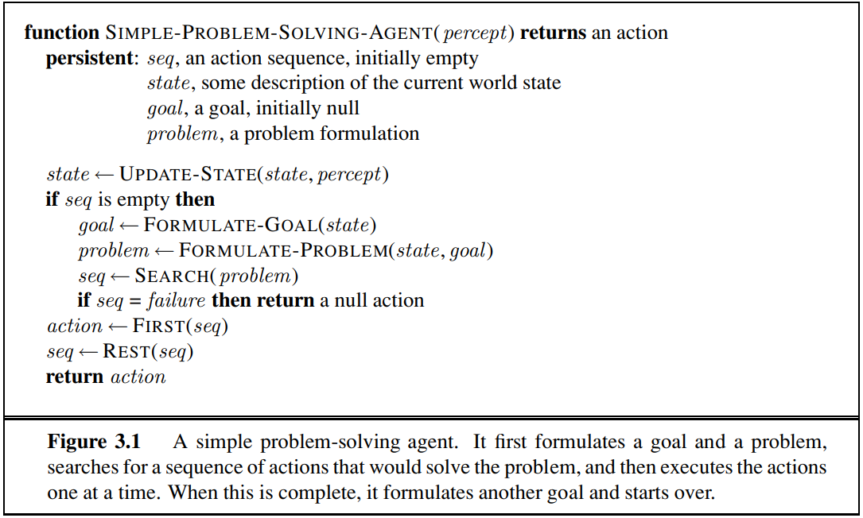
A simple problem-solving agent algorithm

Slide 14
Selecting a state space
Real world is complex. State space must be abstracted for problem solving.
State space is the set of all states reachable from initial by sequence of action.
State = set of real states.
Action = complex combination of real actions.
  e.g. Arad → Zerind represents a complex set of possible routes, detours, rest stops, weather, road condition etc.
  The abstraction is valid if the path between two states is reflected in the real world.
Solution
  action sequence that leads from the initial state to a goal state.
  Solution quality is measured by the path cost function,
  and an optimal solution has the lowest path cost among all solutions.

Slide 15
Example of Problems
Toy Problem – is intended to illustrate or exercise various problem-solving methods. They can be given concise and exact description and hence is usable by different researchers to compare the performance of algorithms.
Examples: Vacuum world, Tic-Tac-Toe, Chess, Sliding-blocks puzzles, etc.
Real-World Problem – is one whose solutions people actually care about. Such problems tend not to have a single agreed-upon description, but we can give the general flavor of their formulations.
Examples: Route-finding problems, TSP, VLSI layout, Robot navigation, Automatic assembly sequencing, Protein design, etc.

Slide 16
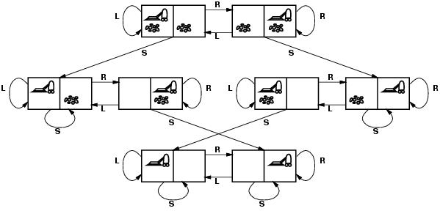
Example: vacuum world
States?
Initial state?
Actions?
Goal test?
Path cost?

Slide 17
Example: vacuum world
States? two locations with or without dirt: total states= nX2^{n}
  2 x 2²=8 where n is number of states in the given problem.
Initial state? Any state can be initial
Actions? {Left, Right, Suck}
Goal test? Check whether squares are clean.
Path cost? Number of actions to reach goal.

Slide 18
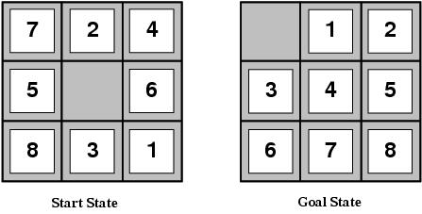
Example: 8-puzzle
States?
Initial state?
Actions?
Goal test?
Path cost?

Slide 19
Example: 8-puzzle
States? Integer location of each tile
Initial state? Any state can be initial
Actions? {Left, Right, Up, Down}
Goal test? Check whether goal configuration is reached
Path cost? Number of actions to reach goal

Slide 20
Goal Formulation
Search
Solution
Execution
Limiting the Objectives of Current State
Looking for sequences of actions
Search algorithm
Takes a problem as input and returns a solution
Executions of the best solution
Problem Formulation
Action and States

Slide 21
Searching for Solutions
How do we find the solutions of previous problems?
  Having formulated some problems, we now need to solve them.
  A solution is an action sequence, so search algorithms work by considering various possible action sequences.
  A search tree is used to model the sequence of actions.
  The possible action sequences starting at the initial state form a search tree with the initial state at the root;
  The actions taken make the branches and the nodes are results of those actions (successor function).
  A node has depth, path cost and associated state in the state space.

Slide 22
Searching for Solutions
The root node of the tree corresponds to the initial state, In(Arad). The first step is to test whether this is a goal state. (Clearly it is not, but it is important to check so that we can solve trick problems like “starting in Arad, get to Arad.”)
Then we need to consider taking various actions. We do this by expanding the current state; that is, applying each legal action to the current state, thereby generating a new set of states.
In this case, we add three branches from the parent node In(Arad) leading to three new child nodes:
  In(Sibiu), In(Timisoara), and In(Zerind). Now we must choose which of these three possibilities to consider further.

Slide 23
Searching for Solutions
This is the essence of search—following up one option now and putting the others aside for later, in case the first choice does not lead to a solution.
  Suppose we choose Sibiu first. We check to see whether it is a goal state (it is not) and then expand it to get In(Arad), In(Fagaras), In(Oradea), and In(RimnicuVilcea).
We can then choose any of these four or go back and choose Timisoara or Zerind. Each of these six nodes is a leaf node, that is, a node with no children in the tree.
The set of all leaf nodes available for expansion at any given point is called the frontier.
The process of expanding nodes on the frontier continues until either a solution is found
or there are no more states to expand.

Slide 24
continued
Search algorithms all share this basic structure; they vary primarily according to how they choose which state to expand next—the so-called search strategy.
So the order of expanding nodes or choosing which state expand next is called search strategy.
Search involves moving the nodes from unexplored region to the explored region.
  As the algorithm runs, it repeatedly removes nodes from the unexplored region (fringe) by expanding them, checking them against the goal, and, if they don’t meet the goal, generating their children.
  After expanding a node, it moves to the explored region, and its child nodes (if any) are added to the unexplored region.

Slide 25
continued
Keeping track of explored and unexplored regions is essential in search algorithms to
  Avoid Redundant Work: Ensuring we don’t revisit or expand nodes repeatedly, which would waste computational resources.
  Prevent Infinite Loops: Especially in search spaces with cycles, moving nodes to the explored region ensures that we don’t get stuck in a loop.
  Optimize Search Efficiency: By keeping a clear boundary between explored and unexplored nodes, we can focus computational efforts on new parts of the search space.
  This concept is central to efficient search algorithms and applies to a variety of search techniques, including tree-based and graph-based search.

Slide 26
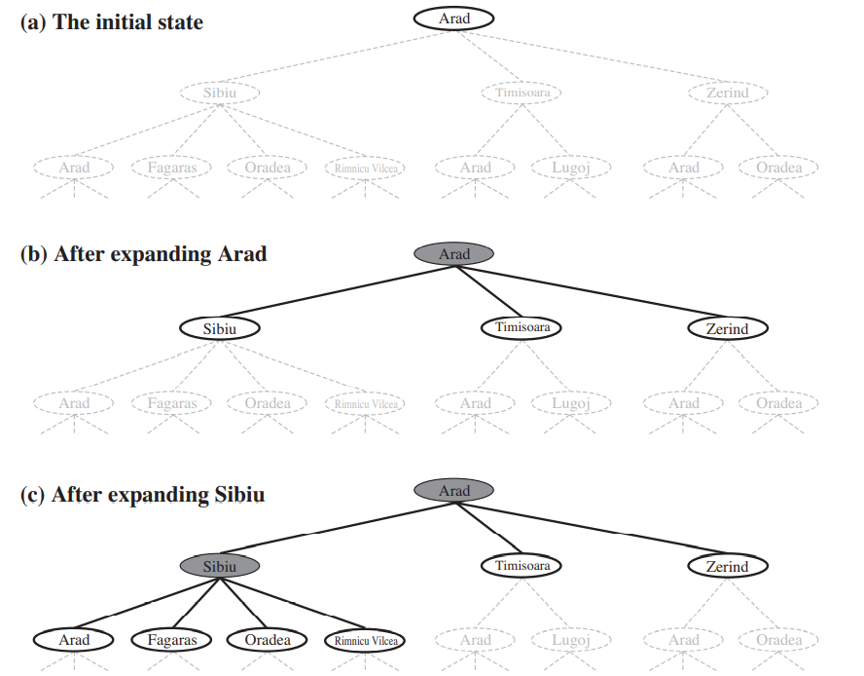
Partial search trees for finding a route from Arad to Bucharest.
Nodes that have been expanded are shaded;
Nodes that have been generated but not yet expanded are outlined in bold;
Nodes that have not yet been generated are shown in faint dashed lines.

Slide 27
Simple Tree Search Algorithm
function TREE-SEARCH(problem, strategy) return solution or failure
Initialize search tree to the initial state of the problem
do
if no candidates for expansion or frontier is empty then return failure
choose leaf node for expansion according to strategy
  if node contains goal state then return solution
  else expand the node and add resulting nodes to the search tree
end do

Slide 28
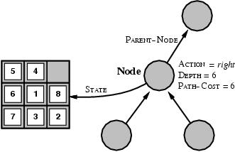
State space vs. search tree
A state is a representation of a physical configuration
A node is a data structure belong to a search tree
  A node has a parent, children, … and includes path cost, depth, …
  Here node= <state, parent-node, action, path-cost, depth>
  FRINGE= contains generated nodes which are not yet expanded or tested.

Slide 29
Tree search algorithm
function TREE-SEARCH(problem, fringe) return a solution or failure
fringe ← INSERT(MAKE-NODE(INITIAL-STATE[problem]), fringe)
loop do
if EMPTY?(fringe) then return failure
node ← REMOVE-FIRST(fringe)
if GOAL-TEST[problem] applied to STATE[node] succeeds
then return SOLUTION(node)
fringe ← INSERT-ALL(EXPAND(node, problem), fringe)

Slide 30
Tree search algorithm Contd..
Successors represent the possible next states that can be reached from the current state by taking each available action.
function EXPAND(node,problem) return a set of nodes
successors ← the empty set
for each <action, result> in SUCCESSOR-FN[problem](STATE[node]) do
s ← a new NODE
STATE[s] ← result
PARENT-NODE[s] ← node
ACTION[s] ← action
PATH-COST[s] ← PATH-COST[node] + STEP-COST(node, action,s)
DEPTH[s] ← DEPTH[node]+1
add s to successors
return successors

Slide 31
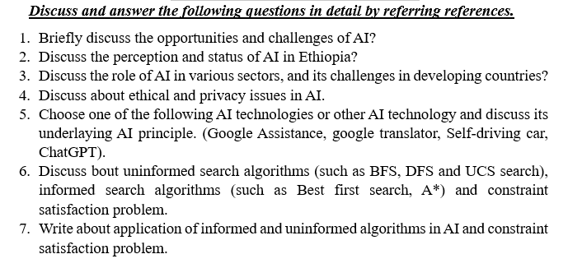
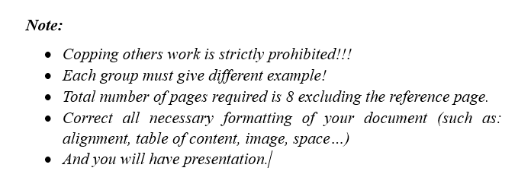
Assignment for G4 SE (Sec A, B)

Slide 32
Thank You

